Slide 1
PID Control and Root Locus Method
SOEN385
Control Systems and Applications

Slide 2
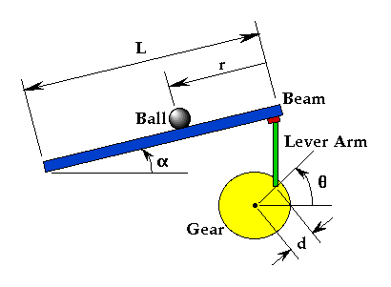
Problem Setup
A ball is placed on a beam, where it is allowed to roll with 1 degree of freedom along the length of the beam.
A lever arm is attached to the beam at one end and a servo gear at the other.

Slide 3
Problem Setup
As the servo gear turns by an angle theta, the lever changes the angle of the beam by alpha.
When the angle is changed from the horizontal position, gravity causes the ball to roll along the beam.
A controller is desirable for this system so that the ball's position can be manipulated.

Slide 4
Problem Setup
We assume that the ball rolls without slipping and friction between the beam and ball is negligible.
The constants and variables for this example are defined as follows:
M mass of the ball 0.11 kg
R radius of the ball 0.015 m
D lever arm offset 0.03 m
g gravitational acceleration 9.8 m/s^2
L length of the beam 1.0 m
J ball's moment of inertia 9.99e-6 kgm^2
r ball position coordinate
α beam angle coordinate
θ servo gear angle

Slide 5
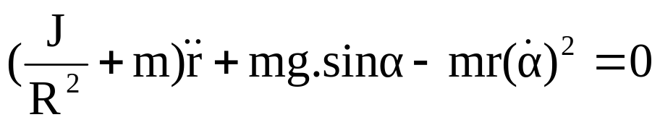
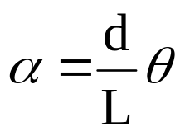
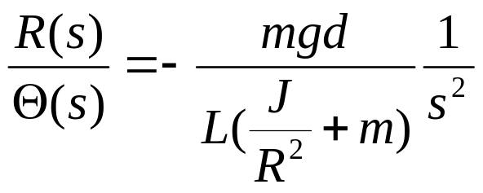
Transfer Function
The Lagrangian equation of motion for the ball is given by:
The beam angle (alpha) can be expressed in terms of the angle of the gear (theta):
The open-loop transfer function of the plant is given below:

Slide 6
Design Criteria
The system is unstable is open-loop. Therefore some method of controlling the ball's position is required.
The design criteria for this problem are:
  Settling time less than 3 seconds
  Overshoot less than 5%

Slide 7
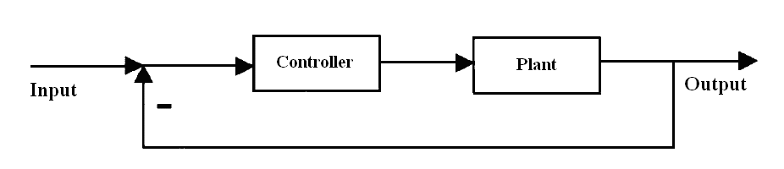
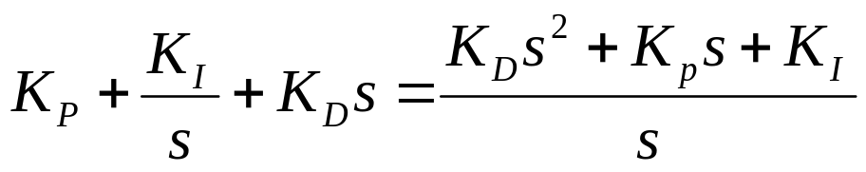
Closed-loop Representation
The block diagram for this example with a controller and unity feedback of the ball's position is shown below:
The transfer function for a PID controller is:

Slide 8
PID Design
General tips for designing a PID controller:
  1. Obtain an open-loop response and determine what needs to be improved.
  2. Add a proportional control to improve the rise time.
  3. Add a derivative control to improve the overshoot.
  4. Add an integral control to eliminate the steady-state error.
  5. Adjust each of KP, KI, and KD until you obtain a desired overall response.
You do not need to implement all three controllers (proportional, derivative, and integral) into a single system.
  Keep the controller as simple as possible.

Slide 9
Proportional Control
First, we will study the response of the system when a proportional controller is used (KD=0 and KI=0). Then, derivative and/or integral control will be added if necessary.
The closed-loop transfer function for proportional control with a proportional gain KP equal to 1, can be modeled by the following lines of code:
m = 0.111;
R = 0.015;
g = -9.8;
L = 1.0;
d = 0.03;
J = 9.99e-6;
K = (m*g*d)/(L*(J/R^2+m));

Slide 10
Proportional Control
num = [-K];
den = [1 0 0];
ball = tf(num,den);
kp = 1;
sys_cl = feedback(kp*ball,1);
Now model the system's response to a step input of 0.25:
step(0.25*sys_cl);

Slide 11
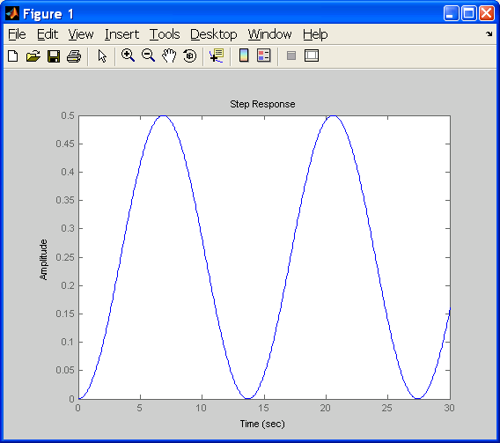
Step Response
Step response with KP equal to 1:

Slide 12
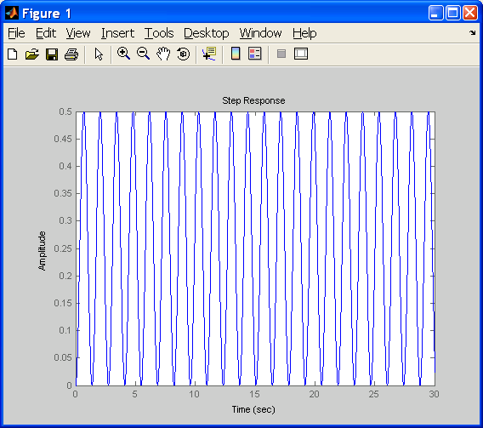
Step Response
The addition of proportional gain does not make the system stable. Try changing the value of KP and note that the system remains unstable.
Step response with KP equal to 100:

Slide 13
Proportional-Derivative Control
Now, we add a derivative term to the controller.
m = 0.111;
R = 0.015;
g = -9.8;
L = 1.0;
d = 0.03;
J = 9.99e-6;
K = (m*g*d)/(L*(J/R^2+m));
num = [-K];
den = [1 0 0];
ball = tf(num,den);

Slide 14
Proportional-Derivative Control
kp = 10;
kd = 10;
contr = tf([kd kp],1);
sys_cl = feedback(contr*ball,1);
t = 0:0.01:5;
step(0.25*sys_cl)

Slide 15
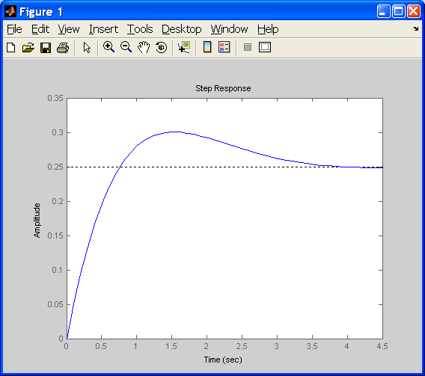
Step Response
Step response with KP =10 and KD =10:
Now the system is stable, but the overshoot is too high and the settling time needs to go down a bit.

Slide 16
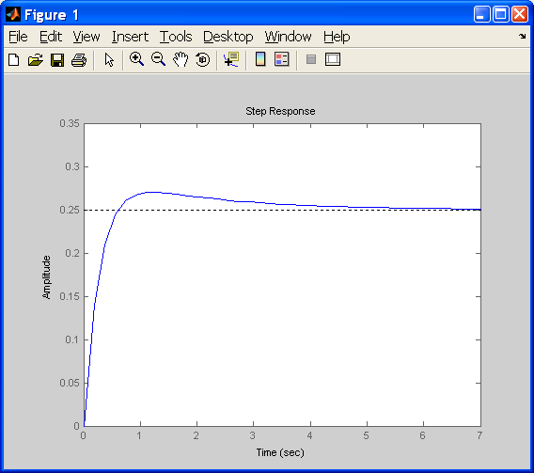
Step Response
By increasing KD we can lower the overshoot and decrease the settling time slightly. Therefore, we set KD to 20 and run the simulation again.
The overshoot criterion
is met but the settling
time needs to come
down a bit.

Slide 17
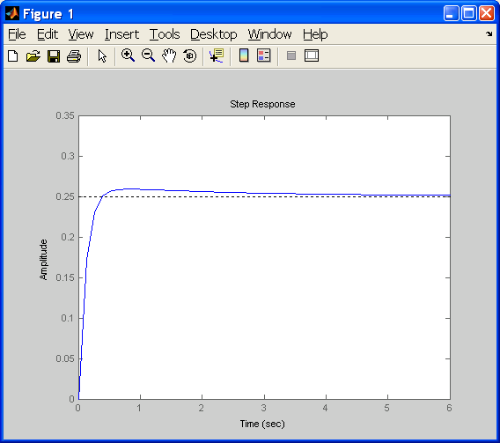
Step Response
To decrease the settling time we may try increasing KP slightly. The derivative gain KD can also be increased to take off some of the overshoot that increasing KP will cause.
Step response with KP =15 and KD =40:
All the control objectives
have been met without
the use of an integral
controller

Slide 18
Root Locus Method
The main idea of the root locus design is to estimate the closed-loop response from the open-loop root locus plot.
By adding zeros and/or poles to the original system (adding a compensator), the root locus and thus the closed-loop response will be modified.
Let us first view the root locus for the plant in open loop:
m = 0.111;
R = 0.015;
g = -9.8;
L = 1.0;
d = 0.03;
J = 9.99e-6;

Slide 19
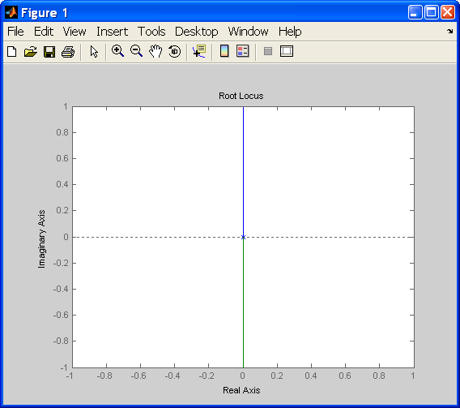
Root Locus Method
K = (m*g*d)/(L*(J/R^2+m));
num = [-K];
den = [1 0 0];
plant=tf(num,den);
rlocus(plant)

Slide 20
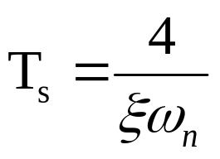
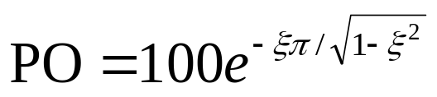
Root Locus Method
The design criteria can also be plotted onto the root locus using the sgrid command.
This command generates a grid of constant damping ratio and natural frequency.
The damping ratio and natural frequency are found using the following equations, which relates them to our percent overshoot (PO) and settling time (Ts) requirements:
From these equations, the damping ratio and natural frequency are found to be 0.7 and 1.9 respectively.

Slide 21
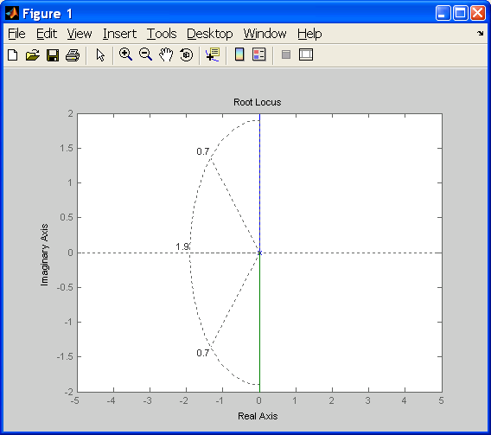
Root Locus Method
sgrid(0.70, 1.9)
axis([-5 5 -2 2])
The area between the two dotted diagonal lines represents locations where the percent overshoot is less than 5%.
The area outside the curved line represents locations where the settling time is less than 3 seconds.
Note that no region of the plot falls within the design criteria shown be these lines.
To remedy this and bring the root locus into the left-hand plane for stability we will try adding a lead-compensator to the system.

Slide 22
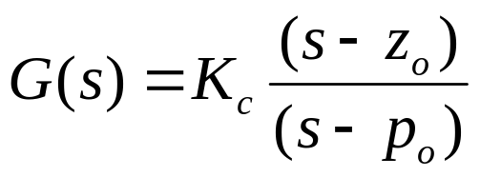
Root Locus Method
Lead Controller
  A first order lead compensator tends to shift the root locus into the left-hand plane.
  A lead compensator has the following form:
  where the magnitude of zo is less than the magnitude of po.

Slide 23
Root Locus Method
Now we add the controller to the plant and view the root locus.
We place the zero near the origin to cancel out one of the poles, and place the pole of our compensator to the left of the origin to pull the root locus further into the left-hand plane:
zo = 0.01;
po = 5;
contr=tf([1 zo],[1 po]);
rlocus(contr*plant)
sgrid(0.70, 1.9)

Slide 24
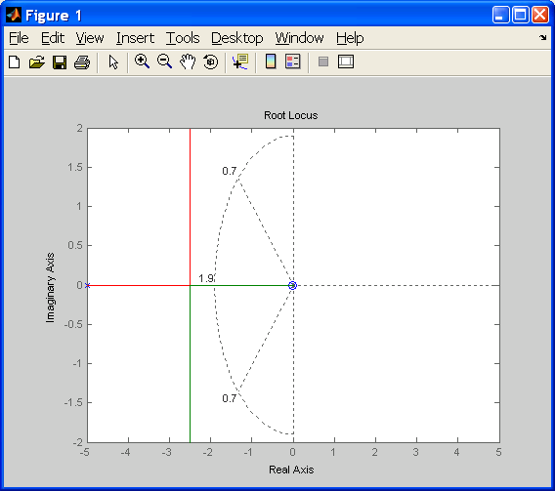
Root Locus Method
Open-loop Root-Locus with Lead Compensator:
Now, the branches of root locus are within our design criteria.

Slide 25
Root Locus Method
Selecting a Gain
  Now that we have moved the root locus into the left-hand plane, we may select a gain that will satisfy our design requirements.
  We can use the rlocfind command to help us do this:
  [k,poles] = rlocfind(contr*plant)

Slide 26
Root Locus Method
Closed-loop Response
  The value of k can be put into the system and the closed-loop response to a step input of 0.25 m can be obtained.
  sys_cl=feedback(k*contr*plant,1);
  t=0:0.01:5;
  figure
  step(sys_cl,t)

Slide 27
References
Control Tutorials for MATLAB and Simulink
http://www.library.cmu.edu/ctms/ctms/index.htm

